Slide 1
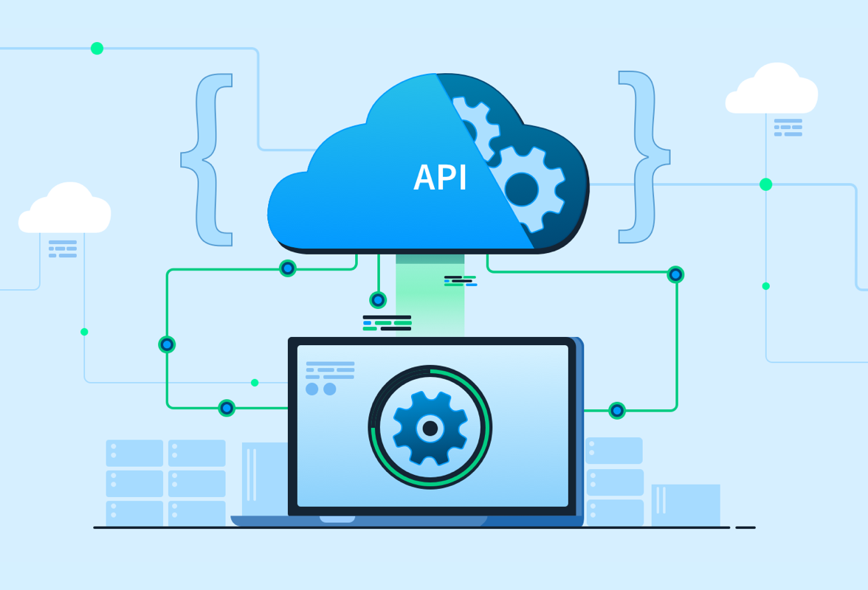
API
Final Project Presentation
Miguel Avila, Federico Rosado

Slide 2
TABLE OF CONTENTS
01
WHAT IS API
02
TYPES & ARCH of APIs
03
COMPONENTS
04
APIs Security
What is an API and how it works?
The difference type and its architecture of APIs
Components need for an API.
Measure to take to protect your API against malicious attacks

Slide 3
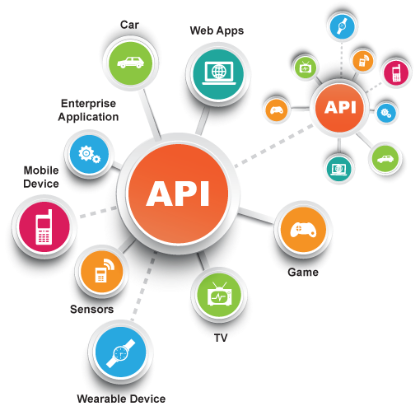
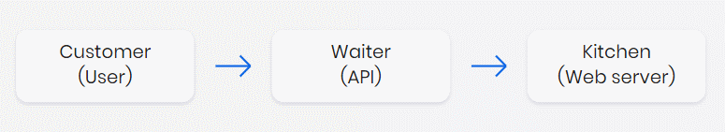
WHAT IS AN API?
WHAT IS?
HOW IT WORKS?
Application Programming Interface (API) is a software interface that allows two applications to interact with each other without any user intervention
API works as a middle layer between the client and the server, making it possible to send data requests and responses.

Slide 4
TYPES & ARCHITECTURES
1
OPEN APIs
1
Representational State Transfer (REST)
2
PARTNER APIs
2
Simple Object Access Protocol (SOAP)
3
INTERNAL APIs
3
RPC
4
COMPOSITE APIs
Also known as external or public APIs, are available to developers and other users with minimal restrictions.
An architectural style of creating web services that communicate with web resources. A collection of guidelines for lightweight, scalable web APIs.
which only authorized developers may access
a stricter protocol for more secure APIs. Works with application layer protocols like HTTP, UDP, and SMTP.
which only internal teams may access.
a protocol for invoking processes that can be written with XML (XML-RPC) or JSON (JSON-RPC).
which combine multiple APIs.

Slide 5
MAIN COMPONENTS
Server Hosting
Database Storage
Data Protection
Programming Language
How and where it will be stored
Encryption methods to secure sensitive data
PL choice to develop the API

Slide 6
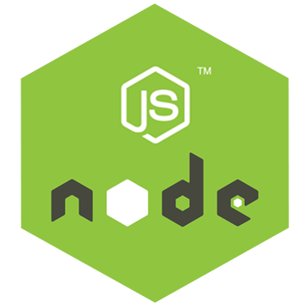



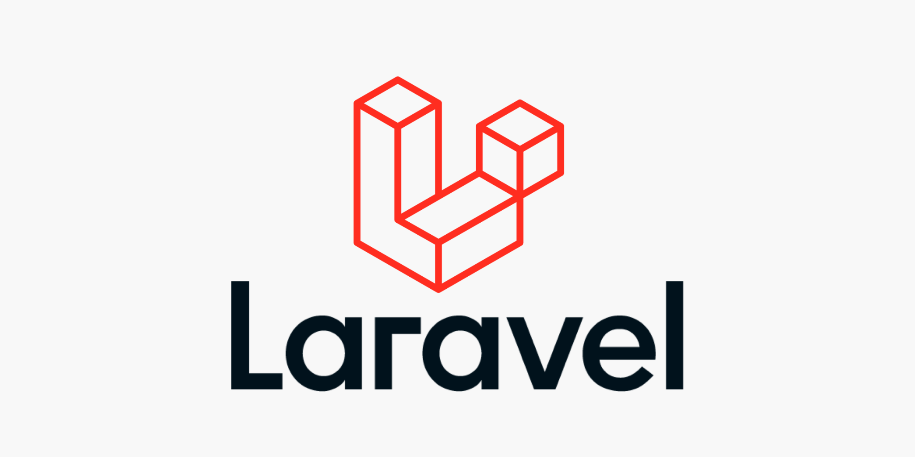
TECHNOLOGIES STACK CHOICES

Slide 7
TECHNOLOGIES STACK CHOICES
CHOICES 1
CHOICES 2
Golang - Gin
Nginx
Postgres / Mysql
JS - Express js
Nginx / Azure
Postgres / Mysql

Slide 8
APIs Common Attack
Man in the Middle Attack
API Injection Attacks
Distributed Denial of Service (DDoS) Attack
Data Scraping

Slide 9
APIs Security Consideration
Authentication (proving who you really are)
Authorization (limiting what you are allowed to)
Identification [Token] (who is accessing your API)
Encryption (encrypt sensitive data in case your data is leaked)
Validate Input Parameters
Monitor and Log Relevant Data

Slide 10
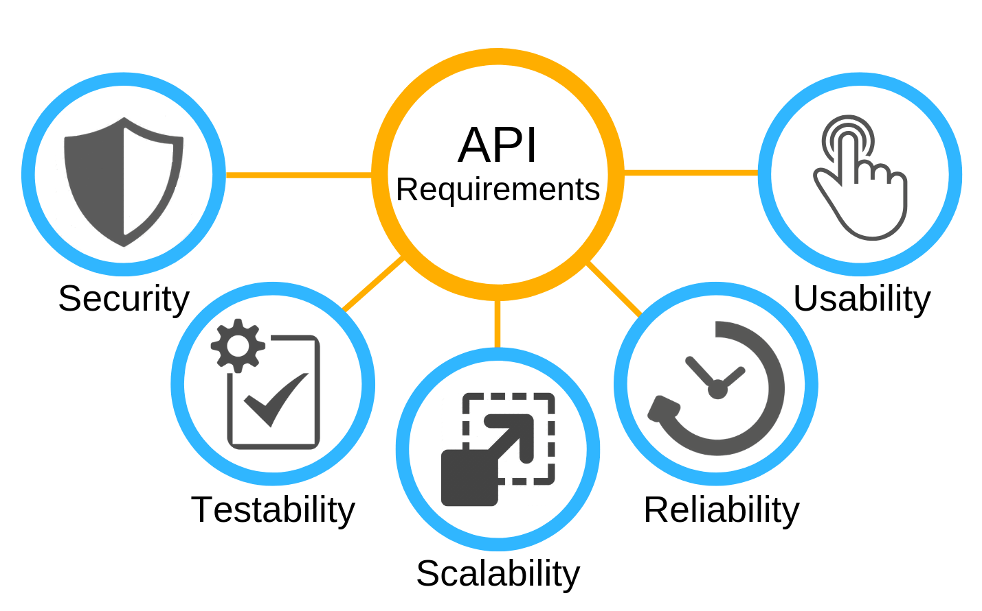
Designing the API

Slide 11
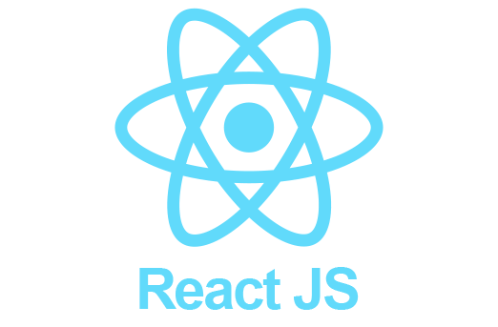




FRONTEND CHOICES

Slide 12
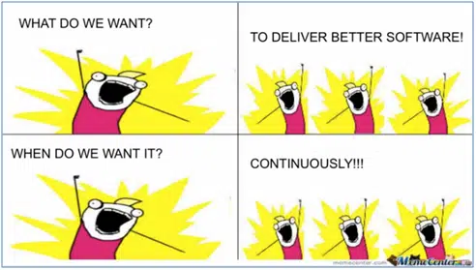
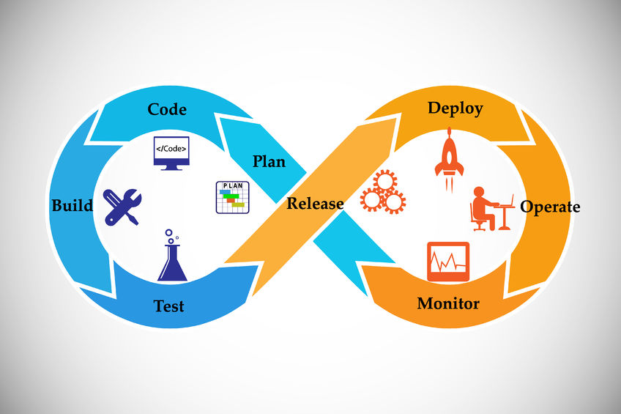
DEPLOYMENT?
HOW IT WORKS?
Software deployment refers to the process of making the application work on a target device, whether it be a test server, production environment or a user's computer or mobile device.
Notes:
API is defined as a code that helps two different application to communicate and exchange data with each other.
Imagine you’re a customer at a restaurant. The waiter (the API) functions as an intermediary between customers like you (the user) and the kitchen (web server). You tell the waiter your order (API call), and the waiter requests it from the kitchen. Finally, the waiter will provide you with what you ordered.

Slide 13
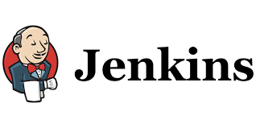
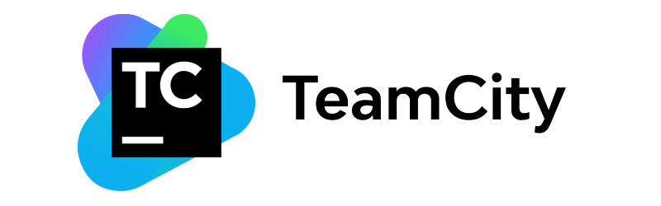
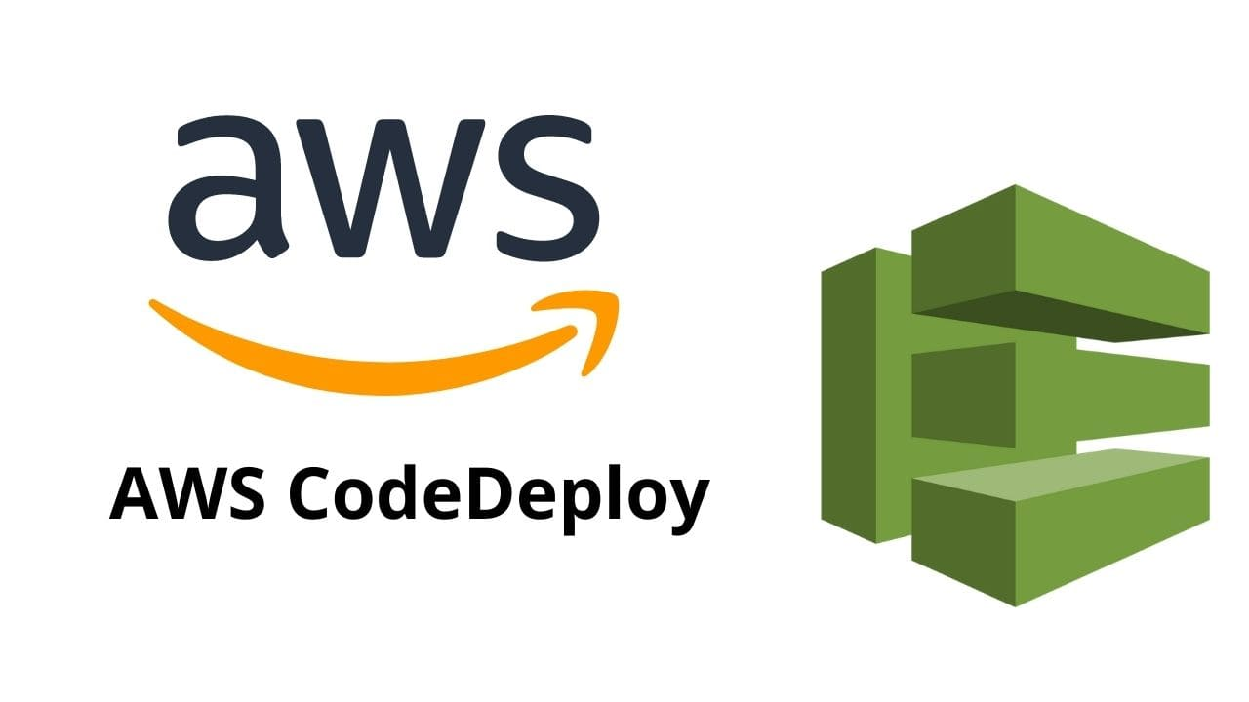


TOOLS
Notes:
API is defined as a code that helps two different application to communicate and exchange data with each other.
Imagine you’re a customer at a restaurant. The waiter (the API) functions as an intermediary between customers like you (the user) and the kitchen (web server). You tell the waiter your order (API call), and the waiter requests it from the kitchen. Finally, the waiter will provide you with what you ordered.

Slide 14
What we learned from this course?
Proper API Development
Further Understanding on API Architecture
Golang
Learn how to Utilize the JSON format in web APIs
Learn how to Perform SQL migrations
Notes:
API is defined as a code that helps two different application to communicate and exchange data with each other.
Imagine you’re a customer at a restaurant. The waiter (the API) functions as an intermediary between customers like you (the user) and the kitchen (web server). You tell the waiter your order (API call), and the waiter requests it from the kitchen. Finally, the waiter will provide you with what you ordered.

Slide 15
Thank You

